Slide 1
Chapter 5: Ethernet
Introduction to Networks
Notes:
Cisco Networking Academy program
Introduction to Networks
Chapter 5: Ethernet

Slide 2
Chapter 5: Objectives
Upon completion of this chapter, you will be able to:
Describe the operation of the Ethernet sublayers.
Identify the major fields of the Ethernet frame.
Describe the purpose and characteristics of the Ethernet MAC address.
Describe the purpose of ARP.
Explain how ARP requests impact network and host performance.
Explain basic switching concepts.
Compare fixed configuration and modular switches.
Configure a Layer 3 switch.

Slide 3
Chapter 5
5.0 Introduction
5.1 Ethernet Protocol
5.2 Address Resolution Protocol
5.3 LAN Switches
5.4 Summary
Notes:
Chapter 5 Sections

Slide 4
5.1 Ethernet Protocol
Notes:
5.1 Ethernet Protocol

Slide 5
Ethernet Operation LLC and MAC Sublayers
Ethernet
One of the most widely used LAN technologies
Operates in the data link layer and the physical layer
Family of networking technologies that are defined in the IEEE 802.2 and 802.3 standards
Supports data bandwidths of 10, 100, 1000, 10,000, 40,000, and 100,000 Mbps (100 Gbps)
Ethernet Standards
Define Layer 2 protocols and Layer 1 technologies
Two separate sub layers of the data link layer to operate – Logical link control (LLC) and the MAC sublayers
Notes:
5.1.1.1 LLC and MAC Sublayers

Slide 6
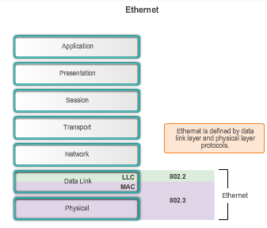
Ethernet Operation LLC and MAC Sublayers (cont.)
Notes:
5.1.1.1 LLC and MAC Sublayers (cont.)

Slide 7
Ethernet Operation LLC and MAC Sublayers (cont.)
LLC
Handles communication between upper and lower layers.
Takes the network protocol data and adds control information to help deliver the packet to the destination.
MAC
Constitutes the lower sublayer of the data link layer.
Implemented by hardware, typically in the computer NIC.
Two primary responsibilities:
Data encapsulation
Media access control
Notes:
5.1.1.1 LLC and MAC Sublayers (cont.)

Slide 8
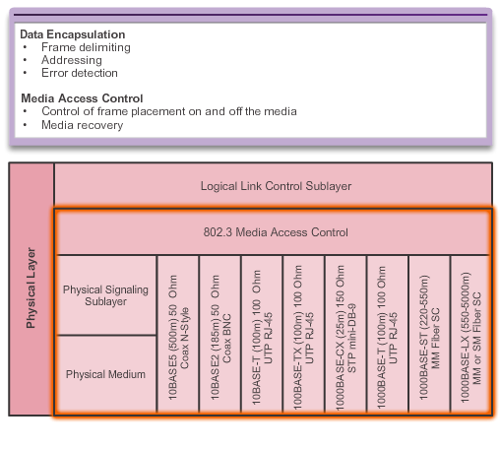
Ethernet Operation MAC Sublayer
Notes:
5.1.1.2 MAC Sublayer

Slide 9
Ethernet Operation MAC Sublayer (cont.)
Data encapsulation
Frame assembly before transmission and frame disassembly upon reception of a frame.
MAC layer adds a header and trailer to the network layer PDU.
Provides three primary functions:
Frame delimiting – Identifies a group of bits that make up a frame, synchronization between the transmitting and receiving nodes.
Addressing – Each Ethernet header added in the frame contains the physical address (MAC address) that enables a frame to be delivered to a destination node.
Error detection – Each Ethernet frame contains a trailer with a cyclic redundancy check (CRC) of the frame contents.
Notes:
5.1.1.2 MAC Sublayer (cont.)

Slide 10
Ethernet Operation MAC Sublayer (cont.)
MAC
Responsible for the placement of frames on the media and the removal of frames from the media
Communicates directly with the physical layer
If multiple devices on a single medium attempt to forward data simultaneously, the data will collide resulting in corrupted, unusable data
Ethernet provides a method for controlling how the nodes share access through the use a Carrier Sense Multiple Access (CSMA) technology
Notes:
5.1.1.2 MAC Sublayer (cont.)

Slide 11
Ethernet Operation Media Access Control
Carrier Sense Multiple Access (CSMA) process
Used to first detect if the media is carrying a signal
If no carrier signal is detected, the device transmits its data
If two devices transmit at the same time - data collision
Notes:
5.1.1.3 Media Access Control

Slide 12
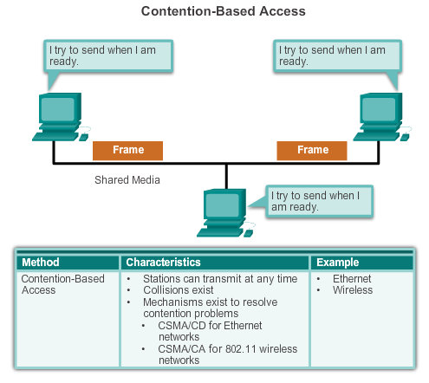
Ethernet Operation Media Access Control (cont.)
Notes:
5.1.1.3 Media Access Control

Slide 13
Ethernet Operation Media Access Control (cont.)
CSMA is usually implemented in conjunction with a method for resolving media contention. The two commonly used methods are: CSMA/Collision Detection and CSMA/Collision Avoidance
CSMA/Collision Detection
The device monitors the media for the presence of a data signal
If a data signal is absent, indicating that the media is free, the device transmits the data
If signals are then detected that show another device was transmitting at the same time, all devices stop sending & try again later
While Ethernet networks are designed with CSMA/CD technology, with today’s intermediate devices, collisions do not occur and the processes utilized by CSMA/CD are really unnecessary
Wireless connections in a LAN environment still have to take collisions into account
Notes:
5.1.1.3 Media Access Control (cont.)

Slide 14
Ethernet Operation Media Access Control (cont.)
CSMA/Collision Avoidance (CSMA/CA) media access method
Device examines the media for the presence of data signal - if the media is free, the device sends a notification across the media of its intent to use it
The device then sends the data.
Used by 802.11 wireless networking technologies
Notes:
5.1.1.3 Media Access Control (cont.)

Slide 15
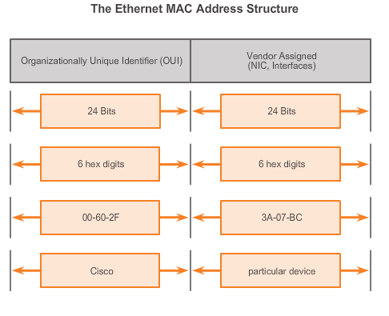
Ethernet Operation MAC Address: Ethernet Identity
Layer 2 Ethernet MAC address is a 48-bit binary value expressed as 12 hexadecimal digits.
IEEE requires a vendor to follow these rules:
Must use that vendor's assigned OUI as the first 3 bytes.
All MAC addresses with the same OUI must be assigned a unique value in the last 3 bytes.
Notes:
5.1.1.4 MAC Address: Ethernet Identity

Slide 16
Ethernet Operation Frame Processing
MAC addresses assigned to workstations, servers, printers, switches, and routers.
Example MACs:
00-05-9A-3C-78-00
00:05:9A:3C:78:00
0005.9A3C.7800.
When a device is forwarding a message to an Ethernet network, attaches header information to the packet, contains the source and destination MAC address.
Each NIC views information to see if the destination MAC address in the frame matches the device’s physical MAC address stored in RAM.
No match, the device discards the frame.
Matches the destination MAC of the frame, the NIC passes the frame up the OSI layers, where the de-encapsulation process takes place.
Notes:
5.1.1.5 Frame Processing

Slide 17
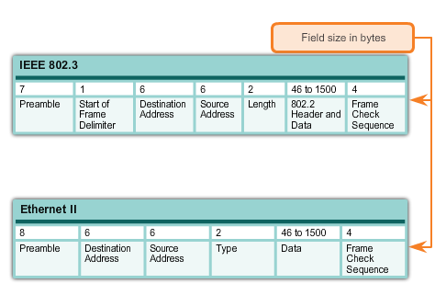
Ethernet Frame Attributes Ethernet Encapsulation
Early versions of Ethernet were slow at 10 Mb/s.
Now operate at 10 Gb/s per second and faster.
Ethernet frame structure adds headers and trailers around the Layer 3 PDU to encapsulate the message being sent.
Ethernet II is the Ethernet frame format used in TCP/IP networks.
Comparison of 802.3 and Ethernet II Frame Structures and Field Size
Notes:
5.1.2.1 Ethernet Encapsulation

Slide 18
Ethernet Frame Attributes Ethernet Frame Size
Ethernet II and IEEE 802.3 standards define the minimum frame size as 64 bytes and the maximum as 1518 bytes
Less than 64 bytes in length is considered a "collision fragment" or "runt frame”
If size of a transmitted frame is less than the minimum or greater than the maximum, the receiving device drops the frame
At the physical layer, different versions of Ethernet vary in their method for detecting and placing data on the media
Notes:
5.1.2.2 Ethernet Frame Size

Slide 19
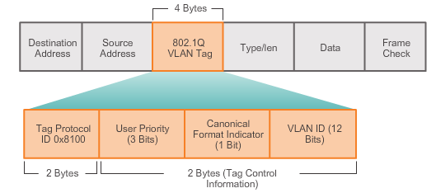
Ethernet Frame Attributes Ethernet Frame Size (cont.)
The figure displays the fields contained in the 802.1Q VLAN tag
Notes:
5.1.2.2 Ethernet Frame Size (cont.)

Slide 20
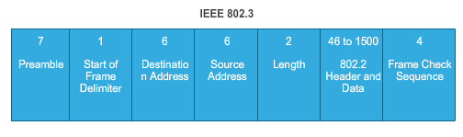
Ethernet Frame Attributes Introduction to the Ethernet Frame
Preamble and Start Frame Delimiter Fields –
Used for synchronization between the sending and receiving devices.
Length/Type Field –
Defines the exact length of the frame's data field; describes which protocol is implemented.
Data and Pad Fields –
Contains the encapsulated data from a higher layer, an IPv4 packet.
Notes:
5.1.2.3 Introduction to the Ethernet Frame

Slide 21
Ethernet Frame Attributes Introduction to the Ethernet Frame (cont.)
Frame Check Sequence Field
Used to detect errors in a frame with cyclic redundancy check (4 bytes); if calculations match at source and receiver, no error occurred.
Notes:
5.1.2.3 Introduction to the Ethernet Frame (cont.)

Slide 22
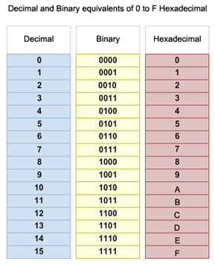
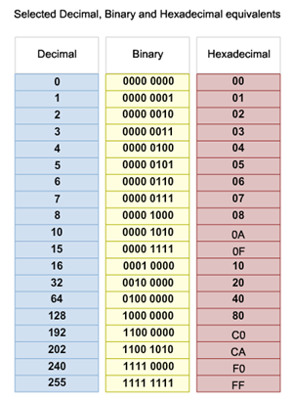
Ethernet MAC MAC Addresses and Hexadecimal
Notes:
5.1.3.1 MAC Addresses and Hexadecimal

Slide 23
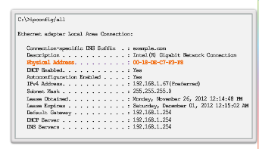
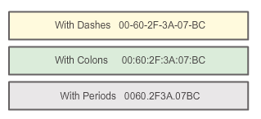
Ethernet MAC MAC Address Representations
Notes:
5.1.3.2 MAC Address Representations

Slide 24
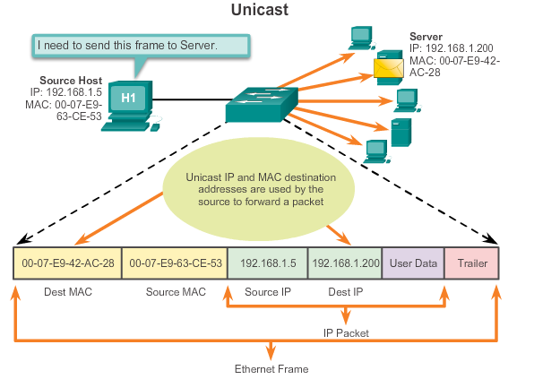
Ethernet MAC Unicast MAC Address
Notes:
5.1.3.3 Unicast MAC Address

Slide 25
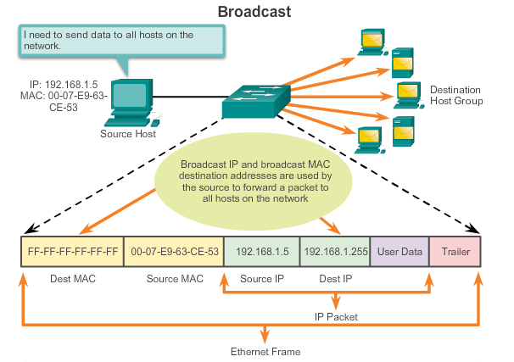
Ethernet MAC Broadcast MAC Address
Notes:
5.1.3.4 Broadcast MAC Address

Slide 26
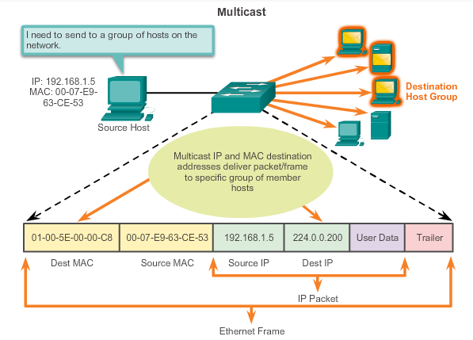
Ethernet MAC Multicast MAC Address
Multicast MAC address is a special value that begins with 01-00-5E in hexadecimal
Range of IPV4 multicast addresses is 224.0.0.0 to 239.255.255.255
Notes:
5.1.3.5 Multicast MAC Address

Slide 27
MAC and IP MAC and IP
MAC Address
This address does not change
Similar to the name of a person
Known as physical address because physically assigned to the host NIC
IP Address
Similar to the address of a person
Based on where the host is actually located
Known as a logical address because assigned logically
Assigned to each host by a network administrator
Both the physical MAC and logical IP addresses are required for a computer to communicate just like both the name and address of a person are required to send a letter.
Notes:
5.1.4.1 MAC and IP

Slide 28
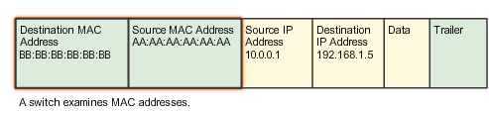
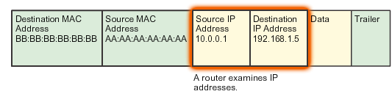
Ethernet MAC End-to-End Connectivity, MAC, and IP
IP Packet Encapsulated in an Ethernet Frame
Notes:
5.1.4.2 End-to-End Connectivity, MAC, and IP

Slide 29
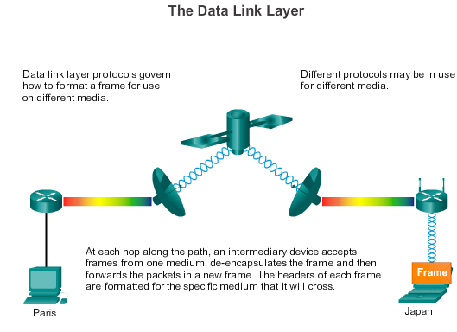
Ethernet MAC End-to-End Connectivity, MAC, and IP (cont.)
Notes:
5.1.4.2 End-to-End Connectivity, MAC, and IP (cont.)

Slide 30
5.2 Address Resolution Protocol
Notes:
5.2 Address Resolution Protocol

Slide 31
ARP Introduction to ARP
ARP Purpose
Sending node needs a way to find the MAC address of the destination for a given Ethernet link
The ARP protocol provides two basic functions:
Resolving IPv4 addresses to MAC addresses
Maintaining a table of mappings
Notes:
5.2.1.1 Introduction to ARP

Slide 32
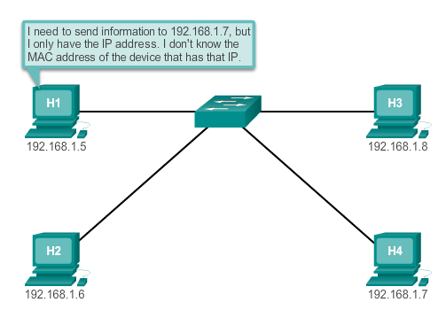
ARP Introduction to ARP (cont.)
Notes:
5.2.1.1 Introduction to ARP

Slide 33
ARP ARP Functions/Operation
ARP Table
Used to find the data link layer address that is mapped to the destination IPv4 address.
As a node receives frames from the media, it records the source IP and MAC address as a mapping in the ARP table.
ARP Request
Layer 2 broadcast to all devices on the Ethernet LAN.
The node that matches the IP address in the broadcast will reply.
If no device responds to the ARP request, the packet is dropped because a frame cannot be created.
Note: Static map entries can be entered in an ARP table, but this is rarely done.
Notes:
5.2.1.2/5.2.1.3 ARP Functions/ARP Operation

Slide 34
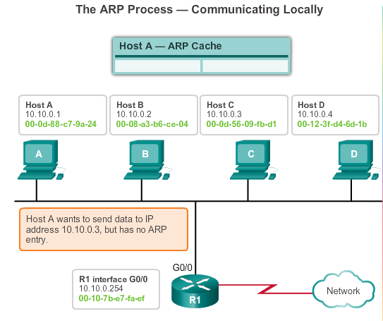
ARP ARP Operation
Notes:
5.2.1.3 ARP Operation

Slide 35
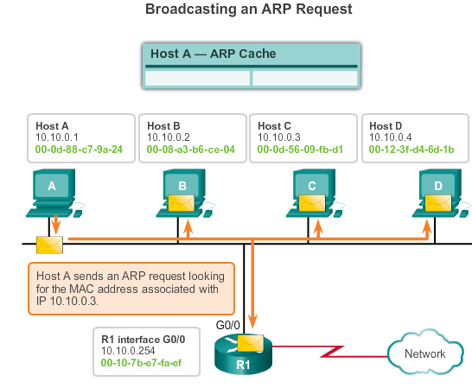
ARP ARP Operation (cont.)
Notes:
5.2.1.3 ARP Operation (cont.)

Slide 36
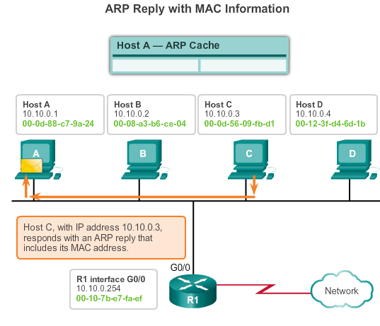
ARP ARP Operation (cont.)
Notes:
5.2.1.3 ARP Operation (cont.)

Slide 37
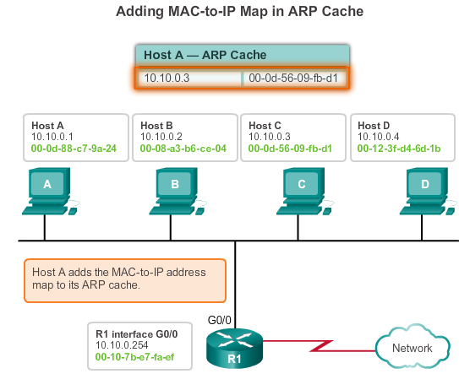
ARP ARP Operation (cont.)
Notes:
5.2.1.3 ARP Operation (cont.)

Slide 38
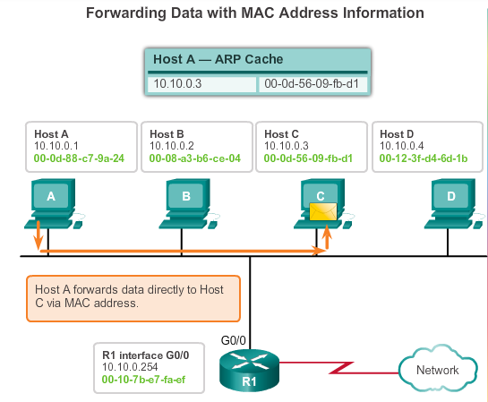
ARP ARP Functions/Operation (cont.)
Notes:
5.2.1.3 ARP Operation (cont.)

Slide 39
ARP ARP Role in Remote Communication
If the destination IPv4 host is on the local network, the frame will use the MAC address of this device as the destination MAC address.
If the destination IPv4 host is not on the local network, the source uses the ARP process to determine a MAC address for the router interface serving as the gateway.
In the event that the gateway entry is not in the table, an ARP request is used to retrieve the MAC address associated with the IP address of the router interface.
Notes:
5.2.1.4 ARP Role in Remote Communication

Slide 40
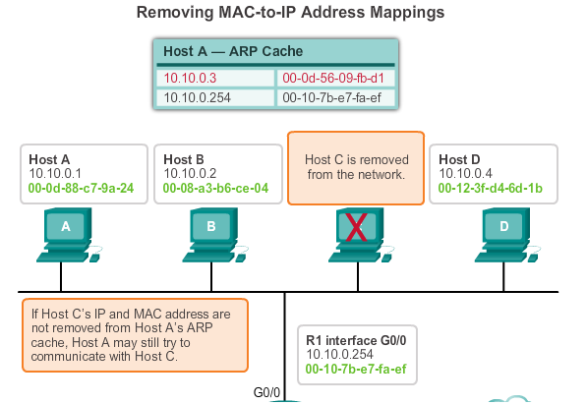
ARP Removing Entries from an ARP Table
The ARP cache timer removes ARP entries that have not been used for a specified period of time.
Commands may also be used to manually remove all or some of the entries in the ARP table.
Notes:
5.2.1.5 Removing Entries from an ARP Table

Slide 41
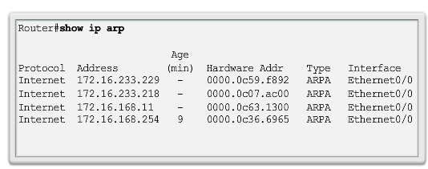
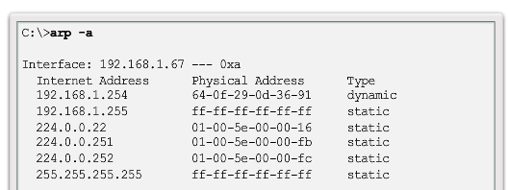
ARP ARP Tables on Networking Devices
Notes:
5.2.1.6 ARP Tables on Networking Devices

Slide 42
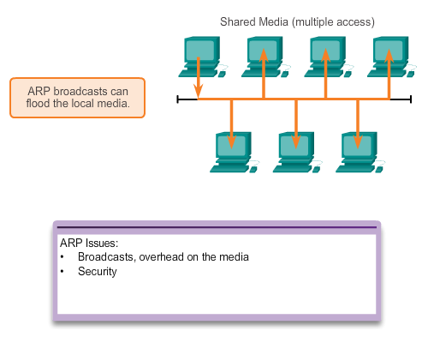
ARP Issues How ARP Can Create Problems
Notes:
5.2.2.1 How ARP Can Create Problems

Slide 43
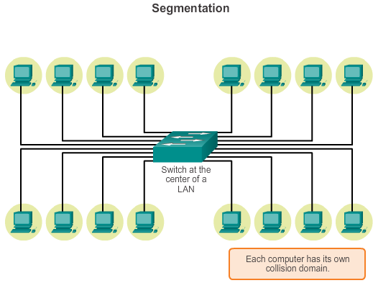
ARP Issues Mitigating ARP Problems
Notes:
5.2.2.2 Mitigating ARP Problems

Slide 44
5.3 LAN Switches
Notes:
5.3 LAN Switches

Slide 45
Switching Switch Port Fundamentals
Layer 2 LAN Switch
Connects end devices to a central intermediate device on most Ethernet networks
Performs switching and filtering based only on the MAC address
Builds a MAC address table that it uses to make forwarding decisions
Depends on routers to pass data between IP subnetworks
Notes:
5.3.1.1 Switch Port Fundamentals

Slide 46
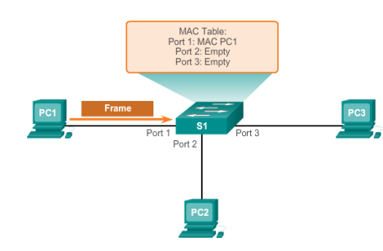
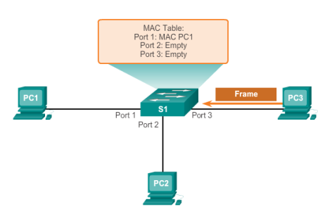


Switching Switch MAC Address Table
1. The switch receives a broadcast frame from PC 1 on Port 1.
2. The switch enters the source MAC address and the switch port that received the frame into the address table.
3. Because the destination address is a broadcast, the switch floods the frame to all ports, except the port on which it received the frame.
4. The destination device replies to the broadcast with a unicast frame addressed to PC 1.
Notes:
5.3.1.2 Switch MAC Address Table

Slide 47
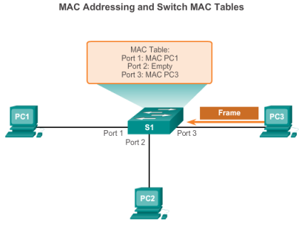
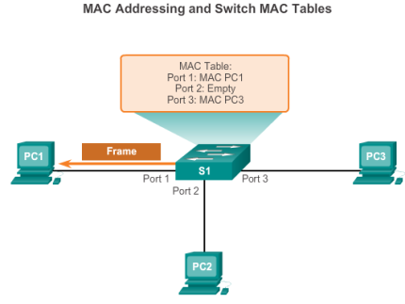
Switching Switch MAC Address Table (cont.)
5. The switch enters the source MAC address of PC 2 and the port number of the switch port that received the frame into the address table. The destination address of the frame and its associated port is found in the MAC address table.
6. The switch can now forward frames between source and destination devices without flooding, because it has entries in the address table that identify the associated ports.
Notes:
5.3.1.2 Switch MAC Address Table (cont.)

Slide 48
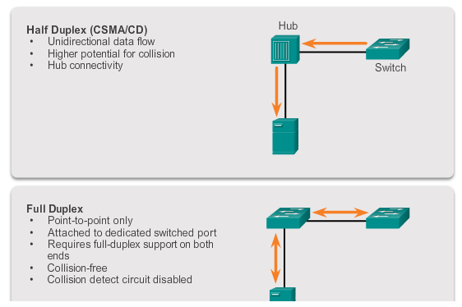
Switching Duplex Settings
Notes:
5.3.1.3 Duplex Settings

Slide 49
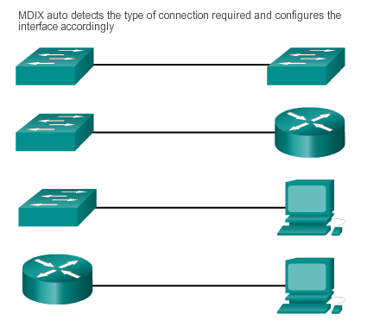
Switching Auto-MDIX
Notes:
5.3.1.4 Auto-MDIX

Slide 50
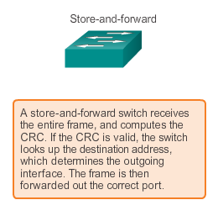
Switching Frame Forwarding Methods on Cisco Switches
Notes:
5.3.1.5 Frame Forwarding Methods on Cisco Switches

Slide 51
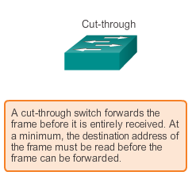
Switching Cut-through Switching
Fast-forward switching:
Lowest level of latency immediately forwards a packet after reading the destination address, typical cut-through method of switching
Fragment-free switching:
Switch stores the first 64 bytes of the frame before forwarding, most network errors and collisions occur during the first 64 bytes
Notes:
5.3.1.6 Cut-Through Switching

Slide 52
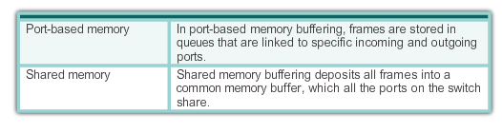
Switching Memory Buffering on Switches
Notes:
5.3.1.8 Memory Buffering on Switches

Slide 53
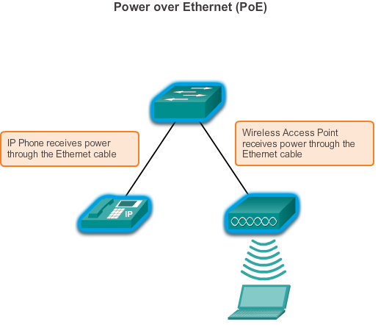
Fixed or Modular Fixed versus Modular Configuration
Notes:
5.3.2.1 Fixed versus Modular Configuration

Slide 54
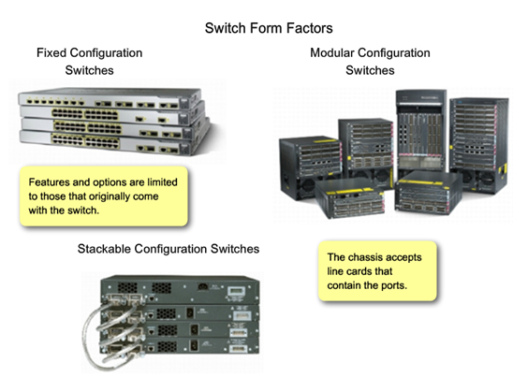
Fixed or Modular Fixed versus Modular Configuration (cont.)
Notes:
5.3.2.1 Fixed versus Modular Configuration (cont.)

Slide 55
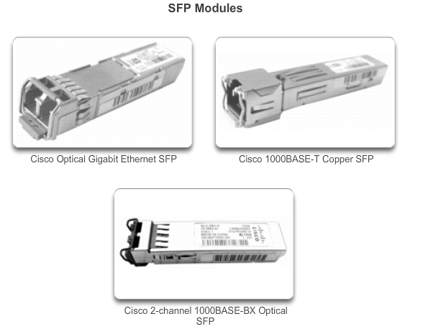
Fixed or Modular Module Options for Cisco Switch Slots
Notes:
5.3.2.2 Module Options for Cisco Switch Slots

Slide 56
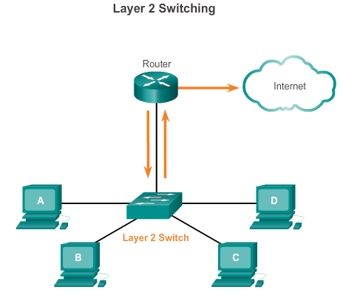
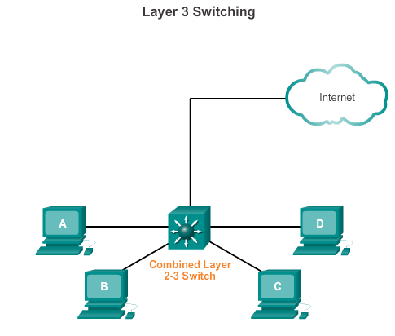
Layer 3 Switching Layer 2 versus Layer 3 Switching
Notes:
5.3.3.1 Layer 2 versus Layer 3 Switching

Slide 57
Layer 3 Switching Cisco Express Forwarding
Cisco devices which support Layer 3 switching utilize Cisco Express Forwarding (CEF). Two main components of CEF operation are the:
Forwarding Information Base (FIB)
Conceptually it is similar to a routing table.
A networking device uses this lookup table to make destination-based switching decisions during Cisco Express Forwarding operation.
Updated when changes occur in the network and contains all routes known at the time.
Adjacency Tables
Maintain layer 2 next-hop addresses for all FIB entries.
Notes:
5.3.3.2 Cisco Express Forwarding

Slide 58
Layer 3 Switching Types of Layer 3 Interfaces
The major types of Layer 3 interfaces are:
Switch Virtual Interface (SVI) – Logical interface on a switch associated with a virtual local-area network (VLAN).
Routed Port – Physical port on a Layer 3 switch configured to act as a router port. Configure routed ports by putting the interface into Layer 3 mode with the no switchport interface configuration command.
Layer 3 EtherChannel – Logical interface on a Cisco device associated with a bundle of routed ports.
Notes:
5.3.3.3 Types of Layer 3 Interfaces

Slide 59
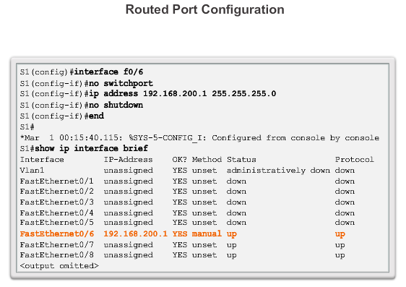
Layer 3 Switching Configuring a Routed Port on a Layer 3 Switch
Notes:
5.3.3.4 Configuring a Routed Port on a Layer 3 Switch

Slide 60
Chapter 5 Summary
Ethernet is the most widely used LAN technology used today.
Ethernet standards define both the Layer 2 protocols and the Layer 1 technologies.
The Ethernet frame structure adds headers and trailers around the Layer 3 PDU to encapsulate the message being sent.
As an implementation of the IEEE 802.2/3 standards, the Ethernet frame provides MAC addressing and error checking.
Replacing hubs with switches in the local network has reduced the probability of frame collisions in half-duplex links.
The Layer 2 addressing provided by Ethernet supports unicast, multicast, and broadcast communications.
Ethernet uses the Address Resolution Protocol to determine the MAC addresses of destinations and map them against known Network layer addresses.
Notes:
Summary

Slide 61
Chapter 5 Summary (cont.)
Each node on an IP network has both a MAC address and an IP address.
The ARP protocol resolves IPv4 addresses to MAC addresses and maintains a table of mappings.
A Layer 2 switch builds a MAC address table that it uses to make forwarding decisions.
Layer 3 switches are also capable of performing Layer 3 routing functions, reducing the need for dedicated routers on a LAN.
Layer 3 switches have specialized switching hardware so they can typically route data as quickly as they can switch.
Notes:
Summary

Slide 62


